Slide 1
COMP 4500
Week 12 - Friday

Slide 2
Last time
What did we talk about last time?
Showing lots of problems are NP-Complete
Started Co-NP

Slide 3
Questions?

Slide 4
Assignment 6

Slide 5
Exam 3 Post Mortem

Slide 6
Logical warmup
You are paddling a canoe around a perfectly circular pond
Enjoying yourself immensely, you fail to notice that a goblin has crept up to the shore
You remember four things from your old lessons on goblin lore
  Goblins can't swim
  Goblins are always hungry for human flesh
  Goblins can run four times as fast as people can paddle canoes
  People can run faster than goblins
The goblin always assumes that you are making for the closest point on the shore and is always trying to cut you off
If you can get to the shore, you can escape, provided that the goblin isn't waiting for you (you need a little margin)
What's your escape strategy?

Slide 7
Co-NP

Slide 8
Asymmetric certification
Efficient certification is asymmetric
A problem is in NP if and only if there is a certificate that can be checked in polynomial time for a "yes" answer
If the answer is "no," there's no requirement for a certificate
How would you give a short certificate that there's no satisfying assignment for 3-SAT?

Slide 9
Co-NP
But there is an alternative definition
Co-NP is the set of all problems for which there is a polynomial-size certificate if the answer is "no"
Both Co-NP and NP problems can certainly be solved with exponential work
Is Co-NP = NP?
No one knows!

Slide 10
What if NP ≠ Co-NP?
Then we would know that P ≠ NP
Proof:
  Consider the contrapositive: (P = NP) $→$ (NP = Co-NP).
  P is closed under complementation. That means that the negated problem (all the strings that would give a "no") is also in P.
  $X∈NP→X∈P→\overline{X}∈P→\overline{X}∈NP→X∈Co\text{−}NP$
  $X∈co\text{−}NP→\overline{X}∈NP→\overline{X}∈P→X∈P→X∈NP$
  Thus, NP = co-NP.
  But, because the contrapositive is logically equivalent, that means that (NP ≠ Co-NP) $→$ (P ≠ NP).
∎

Slide 11
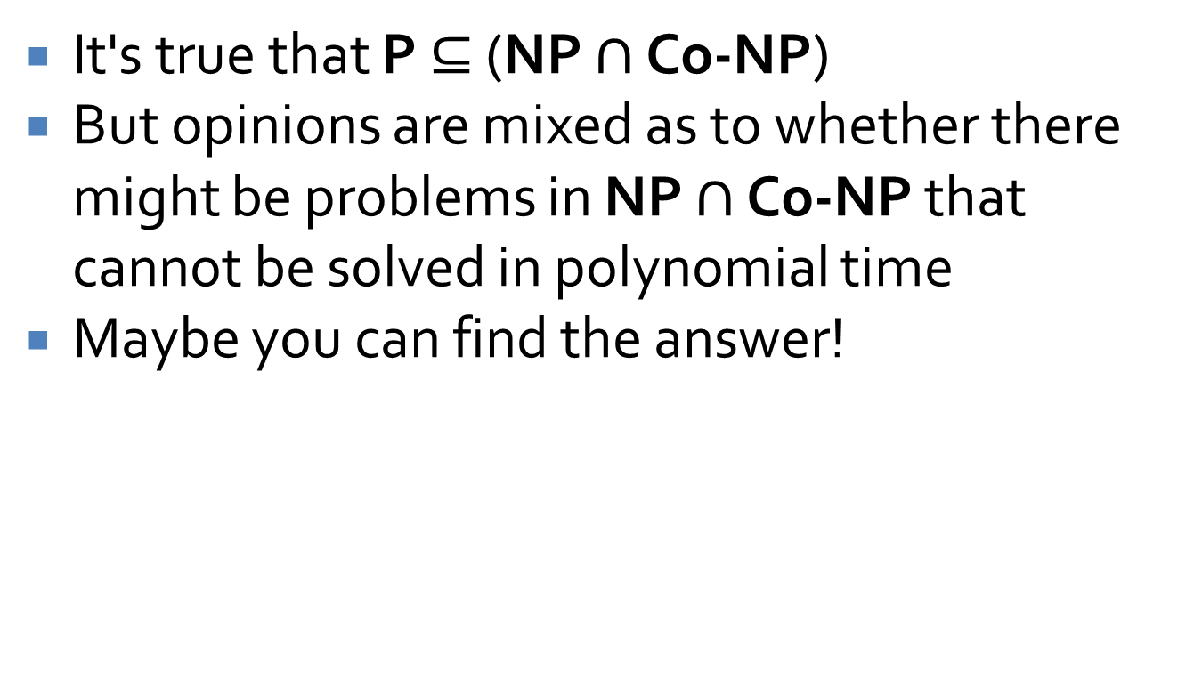
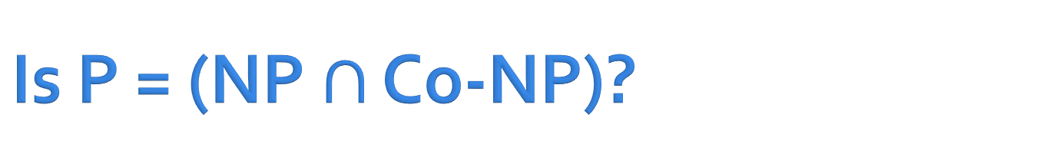
Is P = (NP $∩$ Co-NP)?
It's true that P $⊆$ (NP $∩$ Co-NP)
But opinions are mixed as to whether there might be problems in NP $∩$ Co-NP that cannot be solved in polynomial time
Maybe you can find the answer!

Slide 12
Computability

Slide 13
Turing machine
A Turing machine is a mathematical model for computation
It consists of a head, an infinitely long tape, a set of possible states, and an alphabet of characters that can be written on the tape
A list of rules saying what it should write and should it move left or right given the current symbol and state
A
0 | 0 | 1 | 0 | 1 | 1 | 1 | 1 | 0 | 0 | 0 | 0 | 0

Slide 14
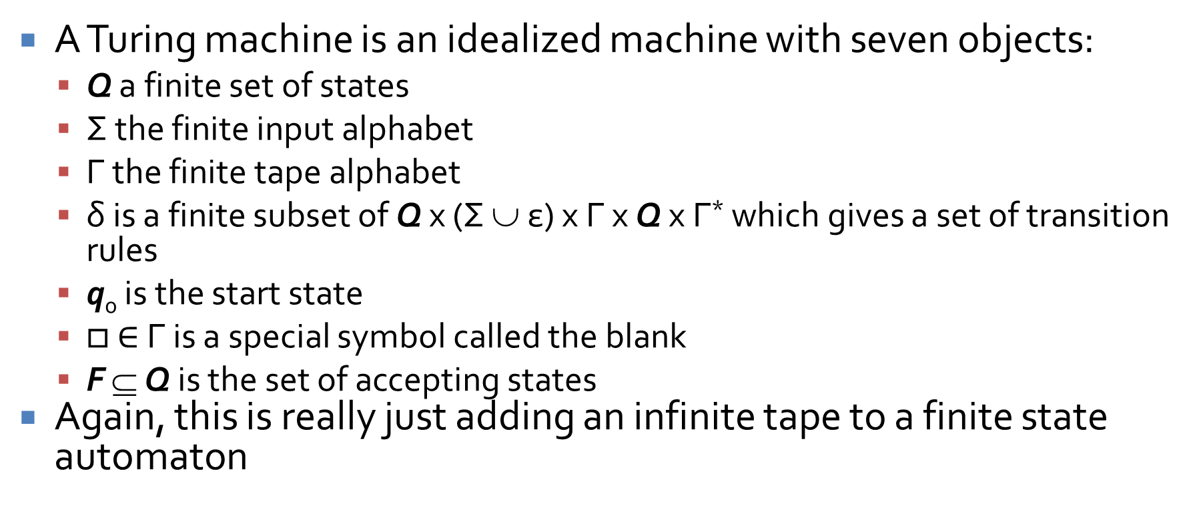
More formally
A Turing machine is an idealized machine with seven objects:
  Q a finite set of states
  Σ the finite input alphabet
  Γ the finite tape alphabet
  δ is a finite subset of Q x (Σ ∪ ε) x Γ x Q x Γ* which gives a set of transition rules
  q₀ is the start state
  $□$ $∈$ Γ is a special symbol called the blank
  F ⊆ Q is the set of accepting states
Again, this is really just adding an infinite tape to a finite state automaton

Slide 15
Turing machine example
You can specify a Turing machine with a table giving its behavior for a specific configuration
Turing's first example machine printed an infinite sequence of alternating 1s and 0s, separated by spaces:
Configuration |  | Behavior
State | Symbol | Operation | Result State
B | Blank | Write 0, Move Right | C
C | Blank | Write Blank, Move Right | E
E | Blank | Write 1, Move Right | F
F | Blank | Write Blank, Move Right | B

Slide 16




A Turing machine as a transition diagram
The transition table from the previous slide can be drawn as a transition diagram too:
$□$, $□$, R
B
C
E
F
$□$, 0, R
$□$, $□$, R
$□$, 1, R

Slide 17
Church-Turing thesis
If an algorithm exists, a Turing machine can perform that algorithm
In essence, a Turing machine is the most powerful model we have of computation
Power, in this sense, means the ability to compute some function, not the speed associated with its computation
Do you own a Turing machine?

Slide 18
Quiz

Slide 19
Upcoming

Slide 20
Next time…
Finish theory of computing
Load balancing
Center selection
Keep reading sections 11.1 and 11.2

Slide 21
Reminders
Assignment 6 due tonight by midnight!

